Slide 1
Preliminary Design Review
XXX Team
CCP-XXX-PDR-XXXX

Slide 2
Pathway to PDR
Following the MCR and based on feedback, the CSA recommends each team to complete the following optional steps before the start of the preliminary design phase:
Conduct an internal Mission Requirements Review (MRR) and System Requirements Review (SRR) to validate the CubeSat mission concept and objectives with all team members.
Validation process should include feasibility, complexity, and constraints (schedule, budget and manpower).
Validation should also include an agreement by the team on the verification and compliance matrix that specifies how each requirement will be demonstrated and at which phase of the project.
Update the programmatic and technical risk matrix and determine the mitigation strategy.

Slide 3
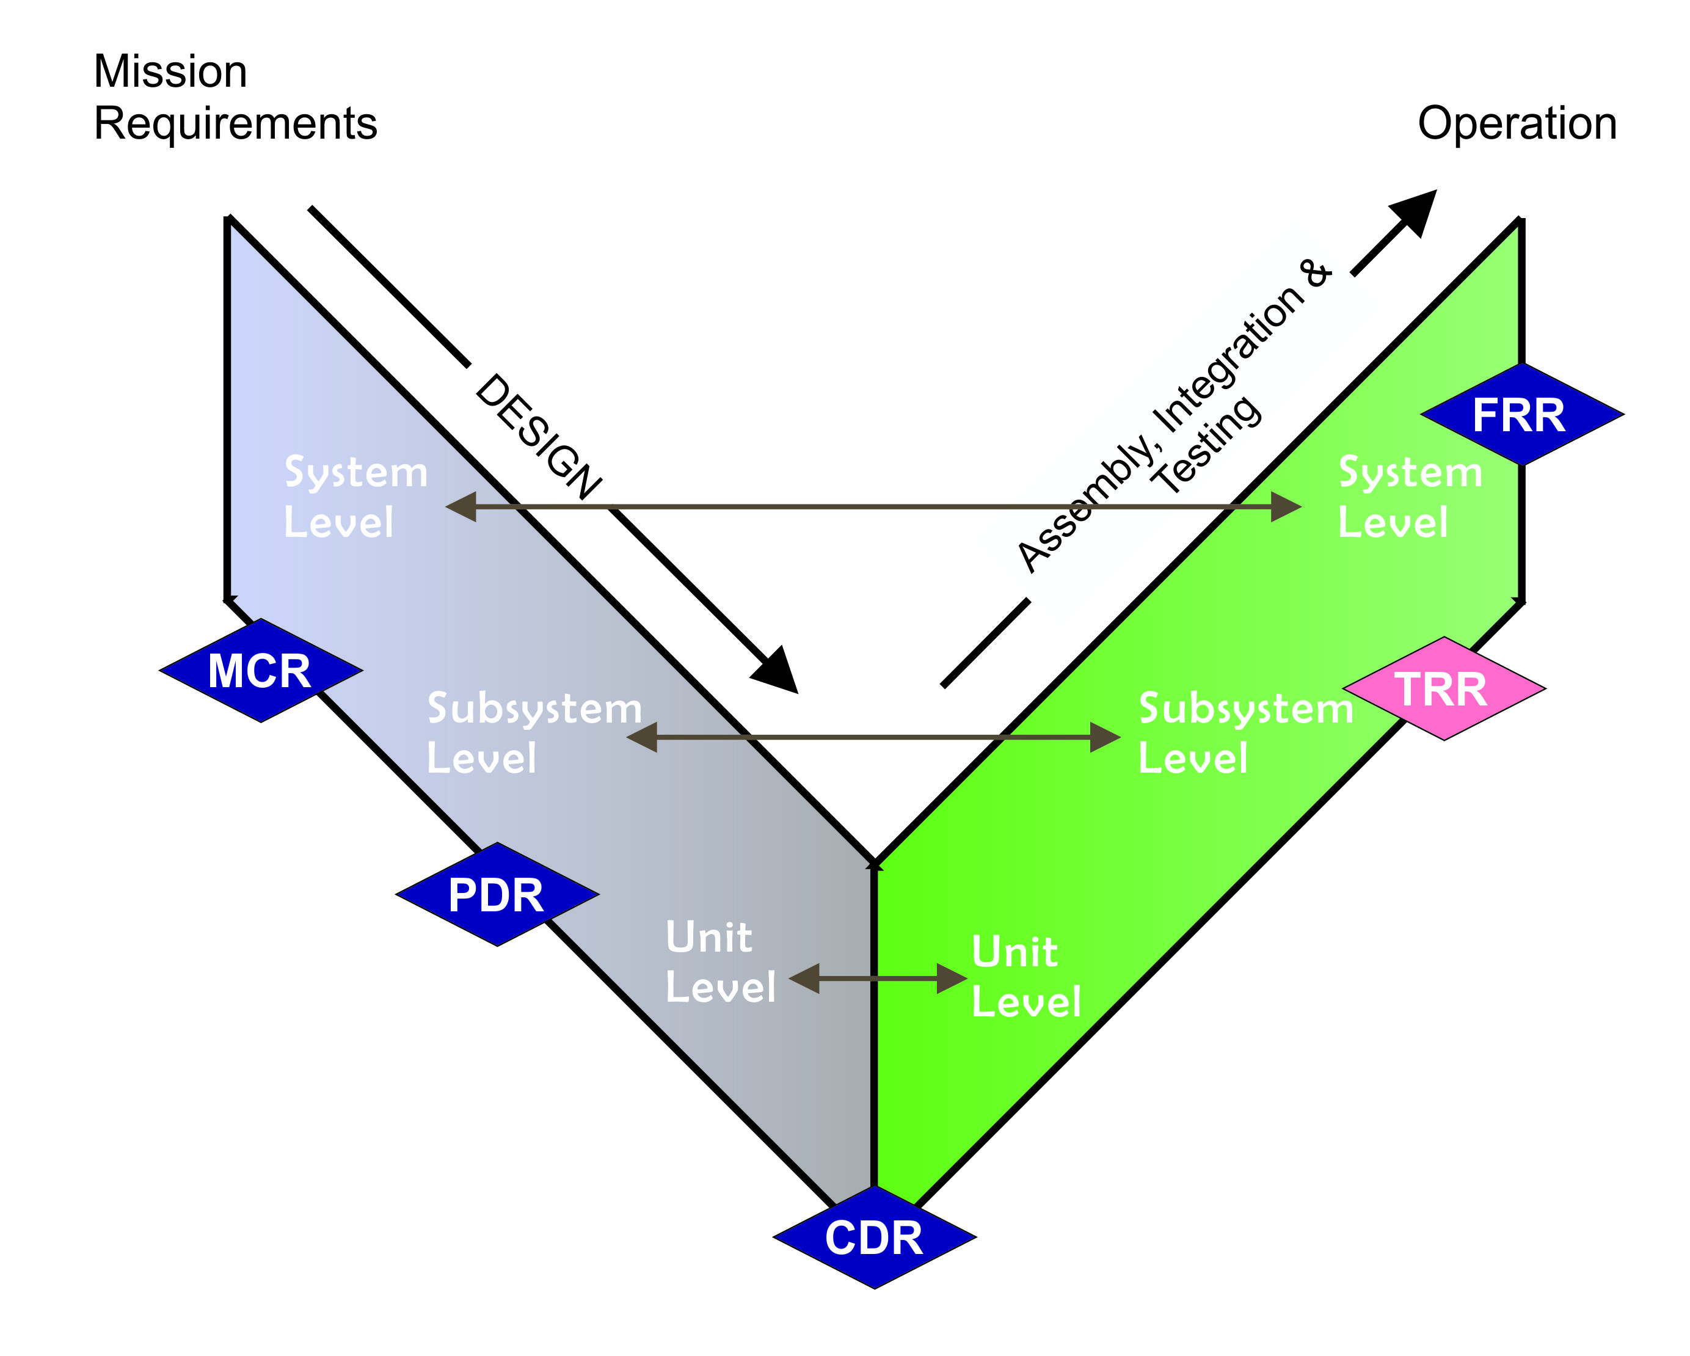
What is PDR?
PDR is the second milestone of the CCP
The purpose of the PDR is to demonstrate that the preliminary design meets all requirements and is feasible within the cost and schedule constraints, and that the project is ready to proceed with the detailed design

Slide 4
Objectives
Verify system and subsystem-level requirements to ensure that they are properly allocated with a verification and validation plan; ensure that flow down of functional and performance requirements are able to meet the objectives of the proposed mission, as well as conformance with safety requirements and standards established by NanoRacks and the CCP Design Specification documents.
Assess proposed hardware components for each subsystem.
Preliminary designs and analyses of a 2U/3U mechanical bus (chassis) showing a detailed layout including all subsystems
Preliminary design of the electrical and power system, cabling/harnesses, grounding diagram, attitude control system configuration and control strategy, RF communications, and flight software development approach
Advanced design of the payload (mechanical, electrical) including detailed ICD and requirements
Preliminary design of the ground segment
Preliminary AIT plan with test specifications and a draft mission operations plan;
Pathway forward to CDR: updated schedule, budget and programmatic risks.
Propose a flatsat model and preliminary design development of the Mechanical Ground Support Equipment (MGSE) and the Electrical Ground Support Equipment (EGSE)

Slide 5
ICD
Properly prepared Interface Control Documents (ICD) is critical for a successful satellite project.
It is recommended to have a System ICD as well as an ICD for each satellite component.
Examples of System ICD and component ICD are uploaded in GC Collab. Please use that as templates and modify accordingly
A component ICD should include information on mechanical, electrical, and signal interface such that every member of the team (electrical, mechanical, systems, software) can find the information necessary to complete his part of design
For example, it is not only the electrical engineer that is interested to know more about the EPS board.
The mechanical engineer needs to know the dimensions, the mass, and the mounting holes.
The software engineer needs to know the pin layout

Slide 6
PDR Deliverable & Schedule
Considering that NanoRacks will participate in PDR, CSA requests ALL teams respect the schedule listed below.
Time | Deliverables
PDR – 3 Weeks | MRD (final), SRD (final), PDR powerpoint (draft), ICD (draft), BOM (1st draft) and SDP (1st draft)
PDR | PDR Powerpoint
PDR + 3 Weeks | Revised 1st draft of BOM and SDP
Document | Acronym
Mission Requirement Document | MRD
Systems Requirement Document | SRD
Bill of Materials | BOM
Safety Data Package | SDP
Interface Control Document | ICD

Slide 7
Proposed PDR Format
It will be by regions with 3 to 6 teams per region.
Allocated time: 4 hours per team per PDR, including questions
At PDR, each team should first present the key mission and systems requirements.
From the systems requirements, demonstrate the flow down to the subsystems requirements level
Present the preliminary design of each subsystems
CSA team provides feedback to each team:
Request for Actions (RFAs) for minor issues that may or may not affect requirements
Review Item Discrepancies (RID) for major issues directly affecting a requirement
Written feedback for each individual PDR
The first draft of Safety Data Package and BOM will be submitted to NanoRacks after PDR
ON TIME DELIVERY OF DOCUMENTS AND POWERPOINT PRIOR TO PDR IS ESSENTIAL FOR SUCCESSFUL PDR

Slide 8
Mission Overview & Payload
~10 slides
Present the overall mission objectives and hence mission requirements
Explain briefly the science background, expected mission outcome, success criteria
Describe payload design and integration to the spacecraft bus;
Describe payload development and test plan;
Describe the concept of operations:
Ground operations strategy (number of G/S, number of daily passes, etc.)
Data generation and analysis
Spacecraft modes and state transitions
Payload operations

Slide 9
Systems Engineering
~15 slides
Showcase the satellite’s internal hardware layout including rework access
Updated systems requirement document up to the subsystems level
Identification and assessment of single-point failure modes
First iteration of the requirements at unit level
First iteration of the CubeSat Interface Control Document (ICD) that includes the power, mechanical, communications, ACS, and on-board processing subsystems
Examples of ICD from a previous CSA/JAXA project are uploaded in GC Collab
Verification and Compliance Matrix

Slide 10
Mechanical System
~15 Slides
Complete mechanical layout with rework access strategy
The design for the deployables and mechanism for the antennas and payload including dimensions, mass and test plan
A mass budget (accounting also for nuts, bolts, connectors, etc.) that demonstrates at least 20% margin
The first draft of Bill of Material is prepared. Although metallic material is not required to be included in BOM for CubeSat of less than 5 kg, it is recommended that they are also listed.
Propose a design of MGSE (mechanical ground support equipment)
Initial thermal analysis should be presented
Notes:
Antenna release on the solar panels

Slide 12
Electrical Power System
~20 Slides
The design of the power subsystems including the inhibits, 30-minute timer, Remove Before Flight (RBF) pin, preliminary grounding diagram.
The power generation subsystems including the solar cell layout and power tracking strategy.
Discuss battery procurement and test plan
Orbit power generation analysis
The power budget that demonstrates at least 20% margin
The interconnect diagrams of all circuit boards
Develop the test plan and test specifications of the electrical subsystems
Notes:
Solar cells are laid out, and the Endurosat has built-in MPPT.
Battery procurement is via Endurosat in their EPS.
Orbit analysis already done, look at that in the documents.
-Does it have a 20% margin..?
Didn’t do interconnect stuff.
Did some test specifications for the solar panels.

Slide 13
EPS – Design of power system - Inhibits
The kill switch inhibits function similarly to the RBF switch.
The Endurosat EPS provides dedicated connectors for kill switches 1 and 2.
The Endurosat EPS will power up the Cubesat when at least 1 of 2 kill switches is released (along with the RBF switch removed).
The 30-minute delay required for ISS deployments will be handled by a timer circuit that will be activated by the kill switches.

Slide 14
EPS – Design of power system - Inhibits
Once 30 minutes have elapsed, the circuit will then allow the EPS to power up via its kill switch connectors.
If the JMP1 pins are inserted on the solar panel (and thus the EPS as well), the 30-minute timer should be disabled. This allows the Cubesat to be quickly powered up or down for testing via the RBF switch.

Slide 15
EPS – Design of power system – 30-minute timer
The 30-minute timer will be an intermediate step between the kill switches and the EPS kill switch connectors.
Upon kill-switch release, the 30-minute timer will begin.
After 30 minutes have elapsed, there will be a ‘closed circuit’ between the two respective pins of the kill-switch connectors.
Once this closed circuit is formed, if the RBF switch has been removed, then the Cubesat will be able to power on.

Slide 16
EPS – Design of power system - RBF
The RBF switch is an audio-jack connector, creating a closed circuit when inserted.
This switch will interface directly with the Endurosat EPS, via its dedicated RBF switch connector. It will not interface with the 30-minute timer.
The functionality of the RBF switch will differ when the JMP1 connector is used. This will disable the self-locking functionality of the EPS, and will power down the Cubesat when the RBF pin is inserted. If JMP1 is not used, inserting the RBF pin WILL NOT power down the Cubesat.

Slide 17
EPS – Design of power system – Jumper pins
The JMP1 and JMP2 connectors of the Endurosat EPS will be exposed via connectors on the solar panels, and provide additional functionality.
The JMP1 connector will – when a closed circuit between the pins is formed – disable the self-locking functionality of the EPS, allowing it the Cubesat to power off when the RBF pin is inserted (whereas if JMP1 is not connected, it will not power off if the RBF pin is inserted).

Slide 18
EPS – Design of power system - Jumper pins
The JMP2 connector – when a closed circuit is formed between the pins – will allow for the batteries of the EPS to be charged via the EPS USB connector.
The EPS USB connector is exposed via the solar panels, and can be used for monitoring and control of the EPS, and charging the batteries when the JMP2 pins are connected together.

Slide 19
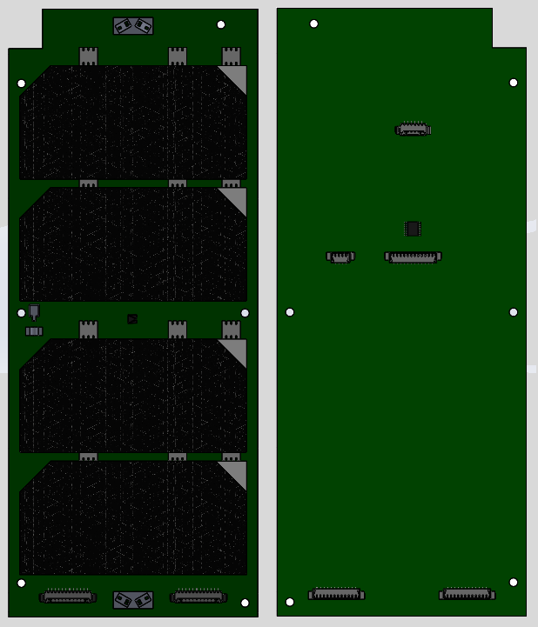
EPS – Power generation subsystems – Solar cell layout
The solar cells selected are AZUR SPACE 3G30A solar cell assemblies.
4 solar cells will be used per panel, and with a collection of 4 panels, a total of 16 solar cells will be used.

Slide 20
EPS – Power generation subsystems
Each solar cell provides ~1.2W of power at about 1367W/m^2 of intensity when perpendicular to the cell surface. Thus each panel may provide a maximum of ~4.8W.
The Endurosat EPS provides Maximum Power Point Tracking (MPPT) via dedicated solar panel connectors.
The Endurosat EPS also provides monitoring and status readouts of each solar panel connected via its USB connector.

Slide 21
EPS – Battery procurement and test plan
The Cubesat batteries are integrated within the Endurosat EPS.
Purchasing dialogue with Endurosat will need to start in order to procure the EPS.
No tests plans as of yet (or are they in the documents? Just leave this blank anyways). Can see if Endurosat tests them for us, or we can check battery life and such, etc.

Slide 22
EPS – Orbit power generation analysis
Orbit power generation analysis
All of this was already done in the Github docs
Can post the table in here.

Slide 23
EPS – 20% margin
The power budget that demonstrates at least 20% margin
This should also be in the Github docs
Worst case, we produce 0W. Nominal case (1 panel illuminated directly is 4.8W. Best case with 2 faces showing, is about 6.5W.

Slide 24
EPS – Circuit board interconnect diagram
This is the interfaces document
The interconnect diagrams of all circuit boards
[Interfaces document mostly finished]

Slide 25
EPS – Test plan and test specifications
Develop the test plan and test specifications of the electrical subsystems
Testing plans in place for the solar panels as they are built. Their final tests are ensuring sensor circuits work as expected, and that it produces the specified max power under a known intensity.
Other tests should include EPS/OBC USB bypass, EPS jumpers, self-lock disable, and charging. Also include accelerometers, since all of these are on the solar panels.

Slide 27
Attitude Determination and Control System
~15 slides
Derivation of nominal attitude configuration (nadir pointing, 3-axis stabilized, etc.) based on mission requirement.
Derivation of attitude knowledge and attitude control requirement.
Proposed ADCS hardware suite (sun sensors, magnetometer, magnetorquer, reaction wheels);
Preliminary assessment of the performance of the proposed attitude control strategy.
Notes:
For attitude determination on the solar panel side, photodiodes are used for determining the sun vector. Additionally, temperature sensors are used to provide more accuracy with the photodiodes.
Rough tests showed that the proposesed attitude determination strategy work, but further testing is required.

Slide 28
Communications Systems
~15 slides
The proposed hardware, data volume for TT&C and payload operation;
The proposed communications protocol for uplink/downlink;
The proposed data downlink strategy (e.g. single vs multiple GS);
The link budget that demonstrates a positive margin.
Initial antenna radiation pattern analysis
Frequency licensing status

Slide 29
Command and Data Handling System
~10 slides
OBC hardware configuration;
Software development approach; (requirements, design, structure, logic flow, language);
Estimated processing load and margin.
Bootloader philosophy
Umbilical interface design for OBC direct access during AI&T phases

Slide 30
AIT
~10 slides
Propose a design of the Electric Ground Support Equipment (EGSE);
Propose a design of the flatsat that will aid in the development of flight software and the verification of operations. Flatsat can be used for:
Test and verify all hardware interfaces
Verify all spacecraft modes and state transitions
Test and verify software commands and procedures
Validate Mission Operations commands and procedures
Validate power transmission for operating modes
Test for failure modes and recovery procedures
Validate ground segment protocols and communications functionality
Propose CubeSat test plan including safety and handling procedure
Present the laboratory environment for spacecraft integration and tests

Slide 31
EGSE & MGSE
Both EGSE (Electrical Ground Support Equipment) and MGSE (Mechanical Ground Support Equipment) are important to satellite project and early planning is recommended
MGSE includes mechanical device (e.g. frame, hoist, hook) and container that allows secure and safe manipulation and integration of CubeSat in laboratory including transportation. Should also include protection devices for lenses and solar array
EGSE includes electronic device (e.g. multimeter, probe), equipment (e.g. laptop, radio) and battery charger that allows testing or updating the CubeSat during integration, transportation, and storage stages. Other components such as lamp and magnet to verify some of the spacecraft sensors should be included.
In designing the EPS and OBC, it is important to include an interface port with the EGSE
In some cases the Payload functionality and characterisation will require ground support equipment that should be presented at PDR.
Notes:
The solar panels provide bypass interfaces to the OBC USB, OBC JTAG, EPS USB, internal accelerometers for vibration testing

Slide 32
Programmatic
~10 slides
Updated schedule, RAM matrix and programmatic risks;
Outreach conducted since MCR;
Status of first draft of Safety Data Package and BOM to CSA/NanoRacks;
Progress review of RF communications license application;
If applicable, progress review of RSSSA application.
High level budget status

Slide 33
Risks Matrix
Update the risk matrix since MCR
Discuss the major risk items and mitigation strategy

